Slide 1

HIRESMART PRESENTS
A SMARTER WAY TO HIRE TOP TALENT
Leveraging Psychometric Precision to Build High-Performing Teams

Slide 2
Introduction
The Science of Selection

Slide 3

BEYOND THE RESUME
Traditional Guesswork
Data-Driven Precision
Resumes and unstructured interviews only reveal 10-20% of potential. Relying on "gut feel" leads to expensive mis-hires and high turnover rates that drain productivity.
Prevue Assessment uses validated psychometrics to see what's beneath the surface. It provides an objective baseline for cognitive aptitude, personality, and internal motivation.

Slide 4
MEASURABLE IMPACT
Immediate Returns
75%
Organizations using Prevue for talent matching see immediate operational improvements. By identifying the right "Job Fit" early, you ensure that new hires are productive from day one.
Increase in Hiring Success
Turnover: Reduced by up to 50%
Time-to-Fill: Decreased by up to 70%

Slide 5






THE "TOTAL PERSON" APPROACH
Cognitive
Personality
Motivation
"Can they do the Job?" Measuring learning speed and cognitive ability.
"How Well Will they do it?" Behavioral tendencies and workplace fit.
"Will they do it?" Aligning passion with daily job functions.

Slide 6


MENTAL AGILITY & APTITUDE
Aptitude as a Predictor
Cognitive ability is the single most reliable predictor of job performance. Prevue evaluates numerical, language, and spatial skills to determine how quickly a candidate can learn.
Measures learning speed
Predicts adaptability
Reduces onboarding time

Slide 7


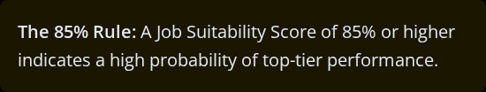
BEHAVIORAL JOB SUITABILITY
Predicting Performance
Personality determines how an individual interacts with teams and handles stress. Prevue measures 13 key traits against custom role benchmarks.

Slide 8

INTERNAL MOTIVATION
Aligning Passion & Task
Skills can be taught, but motivation is innate.
Misalignment in interests—whether someone prefers People, Data, or Things—leads to rapid disengagement.
Prevue ensures that the role matches the candidate's natural preferences, driving long-term satisfaction and loyalty.

Slide 9
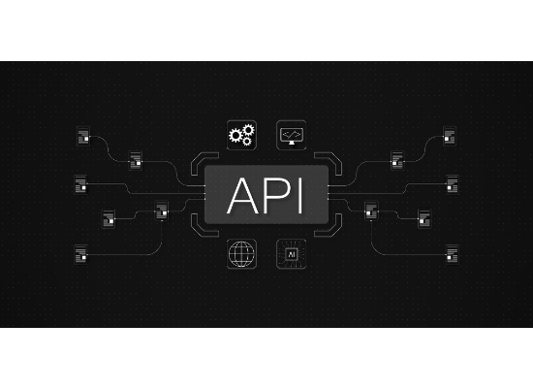
SEAMLESS INTEGRATION
Connect to Your ATS
Prevue integrates effortlessly with the world’s leading Applicant Tracking Systems. No need to switch between platforms—get insights directly in your existing workflow.
Partnering with:
Workday • Oracle • SAP • Taleo • iCIMS • ADP • iSolved • SilkRoad

Slide 10
TALENT DEVELOPMENT
Coaching Sales Performance: Identify the specific personality traits driving revenue and build tailored internal coaching models.
Succession Planning: Identify and prepare future leaders objectively, ensuring internal talent is ready for vacancies.
Corporate Coach Reports: Provide managers with a practical guide to addressing developmental needs for every team member.
Accelerated Onboarding: Use assessment data to shorten the learning curve for new hires.

Slide 11


BUILDING HIGH-PERFORMING TEAMS
The Team-Fit Report
Matches employees to one of nine "Team Characters" based on 13 traits. Highlights communication styles and how team members collaborate most effectively.

Slide 12

Ready for Next Level Hiring?
Experience data-driven success with Prevue Assessment.
Visit us at: hiresmart.com
neil.clark@hiresmart.com 480.205.7291

Slide 13





IMAGE SOURCES
https://media.easy-peasy.ai/e7da9f96-ecf8-44ab-964b-d606ff43c238/b1d8cf98-9ce4-49b8-8e83-1afa8d2eccb8_medium.webp
Source: easy-peasy.ai
https://static.vecteezy.com/system/resources/previews/058/046/252/non_2x/colorful-silhouette-of-a-person-walking-in-abstract-style-png.png
Source: www.vecteezy.com
https://media.easy-peasy.ai/d604cf63-c999-461d-8e59-44461a010be5/7198830d-4596-46ff-93d0-978a3841ea77_medium.webp
Source: easy-peasy.ai
https://webpuppies.com.sg/wp-content/uploads/2025/07/api-connection-graphic-with-nodes-symbols-digital-design-3d-rendering.jpg
Source: webpuppies.com.sg
https://images.stockcake.com/public/f/3/6/f36fc27d-ba6e-40ea-b284-1b63b7c30fee_large/team-high-five-stockcake.jpg
Source: stockcake.com

